Slide 1

Chiranthan Mirle - 1001011399
Abhishek Agarwal - 1000987331
Ranjith M A - 1000969864
Ather Mohammed - 1000993284
Bhavana Nandyala - 1000859140

Slide 2
Vision
To build an interactive, new generation search assistant which helps us find people and places through the touch of a button (Most accurate for outdoors).

Slide 3
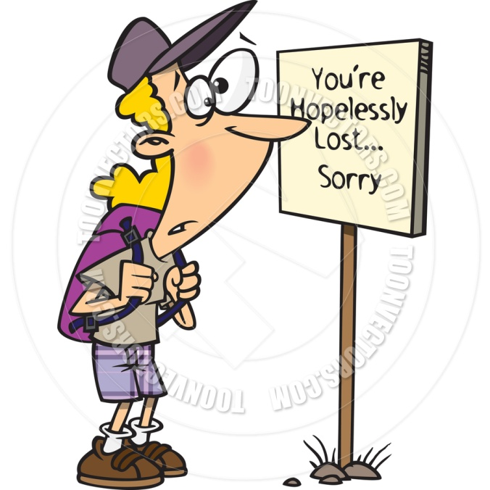
Where am I?

Slide 4

Where's my friend?

Slide 5

Solutions to the problems
To reach a destination you need two parameters

Slide 6
Direction
To know where you are and to proceed to your destination

Slide 7

Distance
After learning the direction, how far should you travel in that particular direction?

Slide 8

I Will use “FindMe”

Slide 9
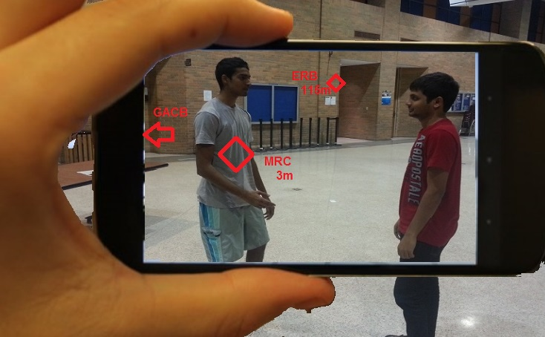
Now this is just what I want!!!

Slide 10

What tools do we use?

Slide 11
Tools that help us in development

Slide 12

GitHub

Slide 13


Android Development Tools
With AVD

Slide 14
Omega Server
omega.uta.edu

Slide 15
How does the device support us?

Slide 16

Camera

Slide 17



Slide 18

Compass

Slide 19
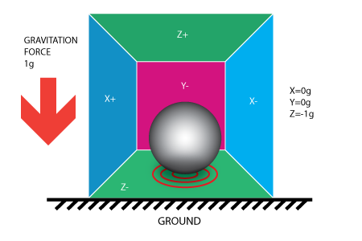

Accelerometer

Slide 20
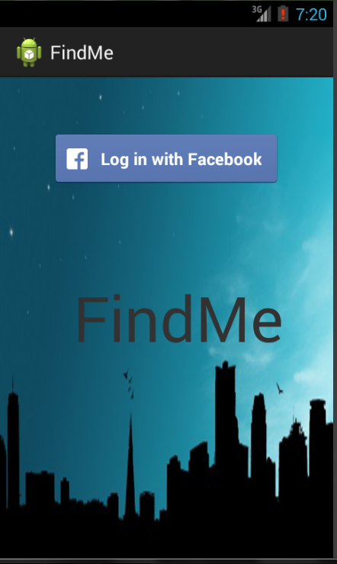
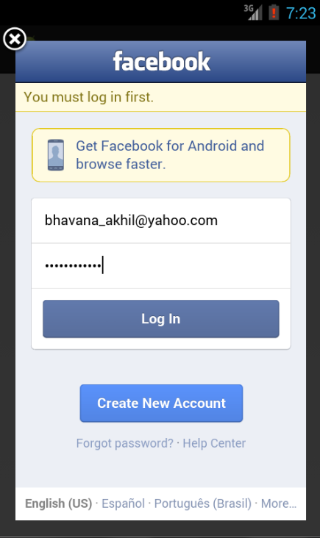
Inputs

Slide 21
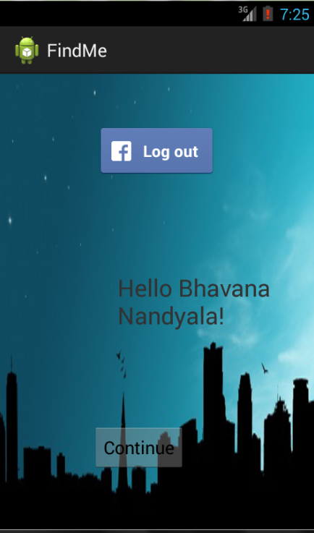
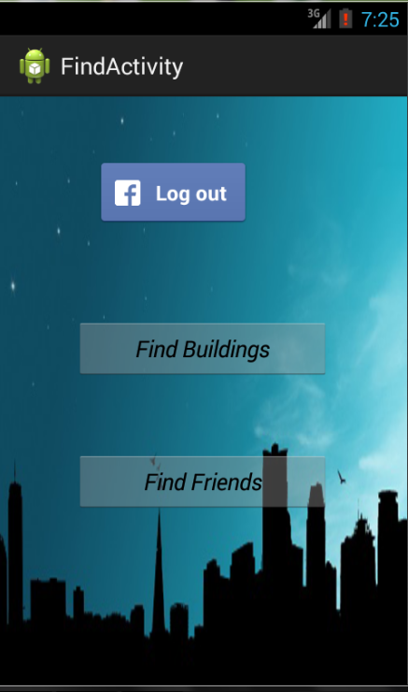

Slide 22
Output

Slide 23
Use case diagram
Find building
Facebook user
Verification
<<system>>
Facebook
password
Find friend

Slide 24
Use case diagram
Location
from
Gps/compass/
accelerometer
to
Friend

Slide 25
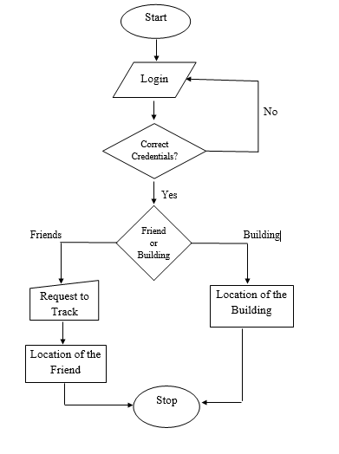
Flow Chart

Slide 26
RISKS
Security.
There can be more than one person using the same username or an imposter.
Application doesn’t provide accurate readings inside the building.
It is highly dependable on Global Positioning system (GPS).

Slide 27
Risk Management
Create a login page, where a student has to enter his/her credentials to use this app.
In order to address the multiple names issue, we will generate the passcode.
In advanced devices, sensors are more accurate; so the app will exactly point to the right person.
Through iterative debugging the app can be brought close to perfection.

Slide 28
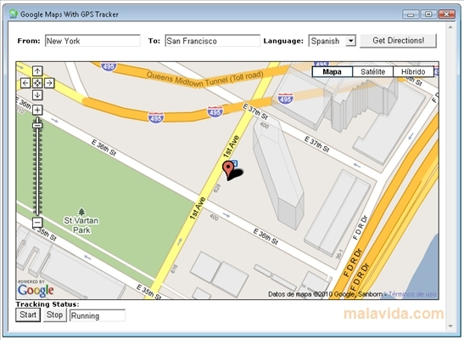

COMPETITORS
Google Maps
AcrossAir

Slide 29
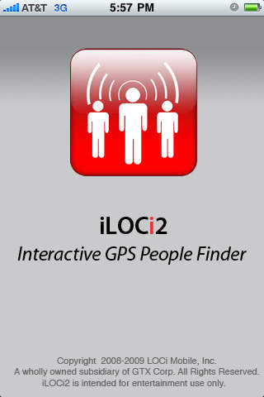
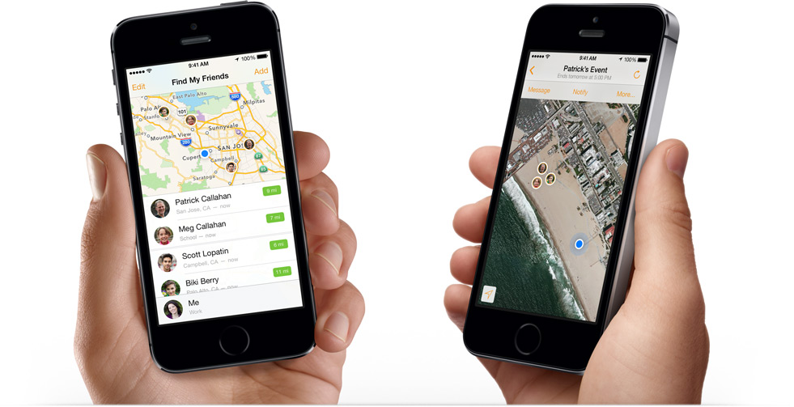
Find my Friends
iLOCi2

Slide 30
FUTURE SCOPE
New students can explore!
Can go global.

Slide 31
ITERATION 1

Slide 32
PLANNED & ACHIEVED
FACEBOOK ID PASSWORD
REGISTRATION
VERIFICATION
CORRECT
NEXT
ENTER
INCORRECT

Slide 33
PLANNED & ACHIEVED
NH
ERB
VERIFICATION
FIND MY FRIEND
FIND BUILDING
NEXT
TO
FROM

Slide 34
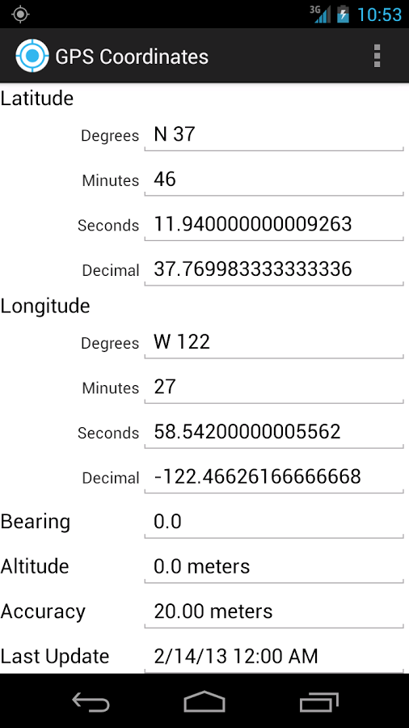
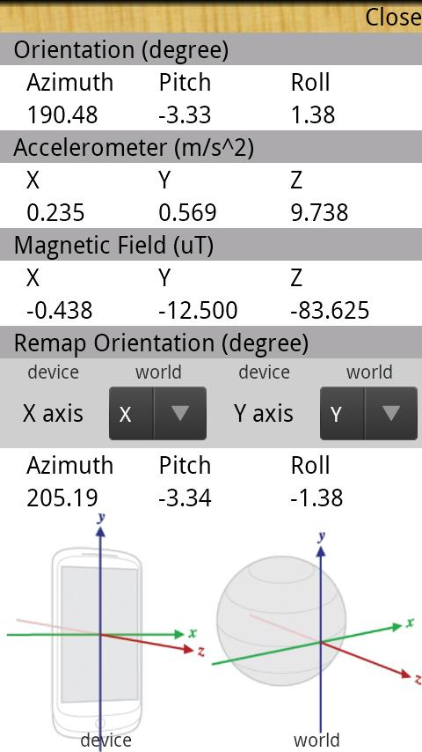
SENSOR READING

Slide 35
TUTORIALS
Android tutorials from www.tutorialspoint.com , http://thenewboston.org and www.stackoverflow.com
Basic algorithm for Finding the slope between two points, and further finding the angle between two slopes

Slide 36
TECHNICAL CHALLENGES
Facebook connectivity
Finding the angle between two slopes
Working of compass
Accuracy with compass reading
Camera view
Pointing an arrow towards the destination

Slide 37
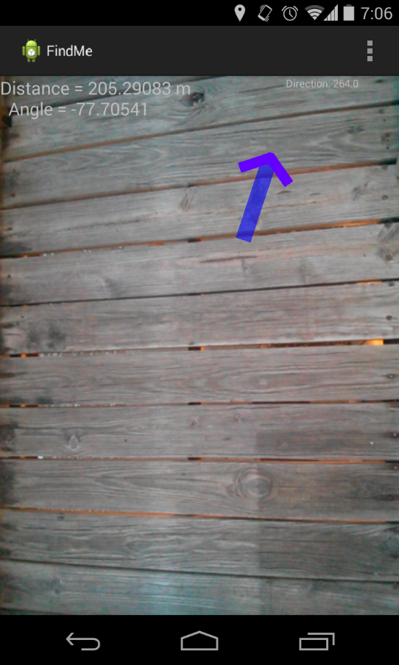
Screen Shots

Slide 38
SENSORS
Accelerometer(X- Axis, Y- Axis, Z- Axis)
Orientation – Compass - Azimuth (Degree)
GPS - Latitude and Longitude

Slide 39
STEPS INVOLVED IN RETRIEVING THE DATA FROM THE SENSORS:-
Obtain a Sensor Manager/ Location Manager.
Register a Sensor Event listener/ Location listener for each of the above sensor types.
Implement SensorEventListener ( 2 Methods)/ LocationListener class (4 Methods).

Slide 40
ITERATION-2 PLAN
We Will introduce categories in building
Categories could be differentiated according to Engineering, Management, Life sciences etc.
Also the find friend part of the application will be introduced
Furthermore, work will be done in order to make the application interactive.

Slide 41
Thank You

